Slide 1
Trusted security for critical infrastructure

Slide 2
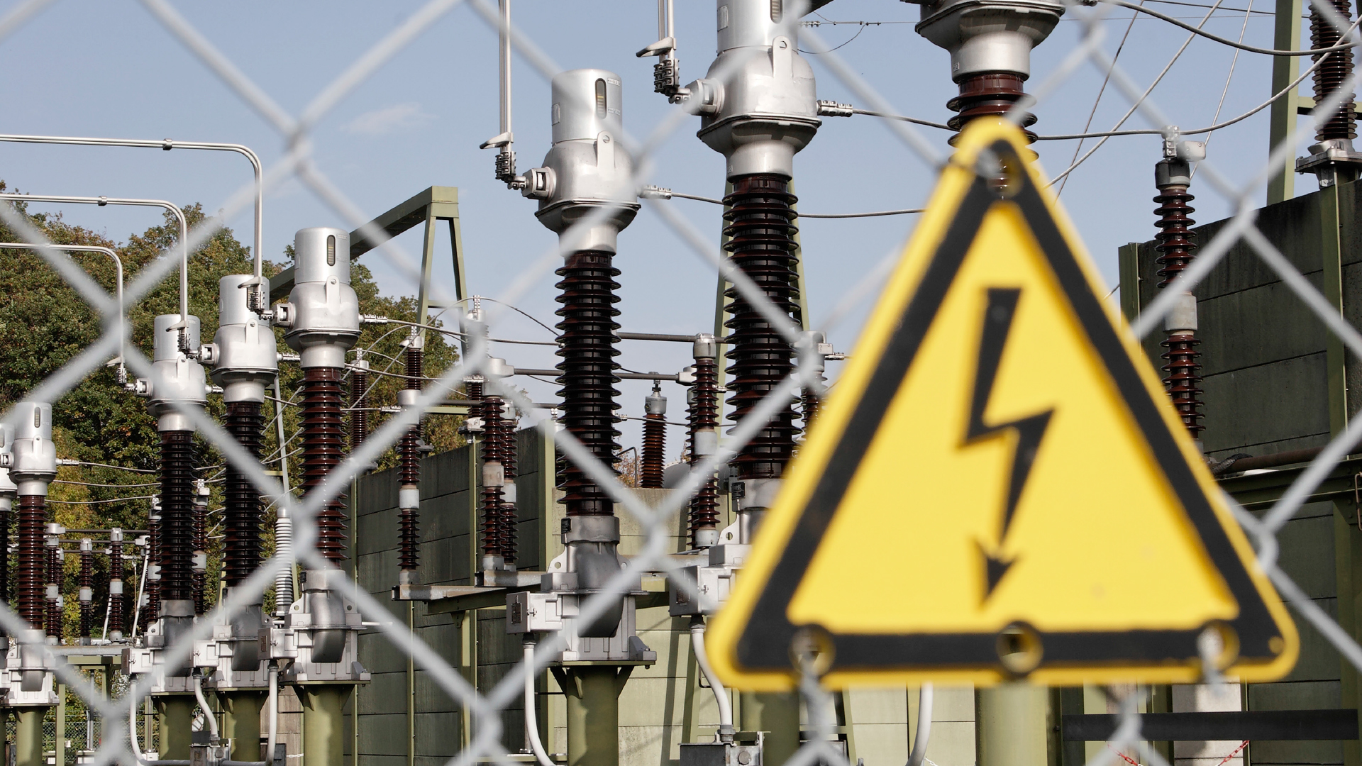
Utility companies face significant threats:
Sabotage
Terrorism
Theft
Fire

Slide 3
Utility companies operate across multiple, complex sites…

Slide 4
… and have a legal obligation to provide services around the clock.

Slide 5
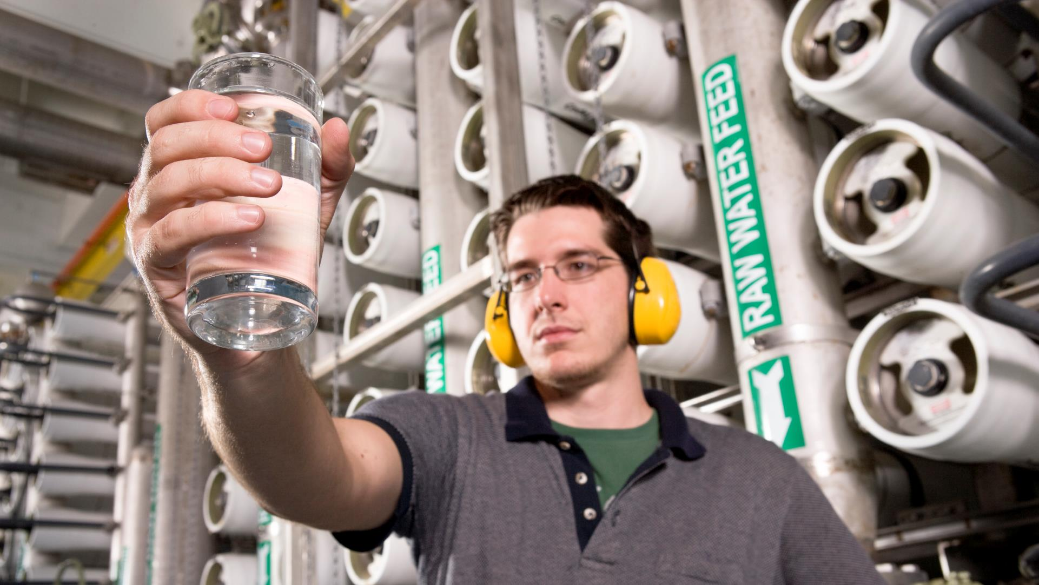
Downtime is a disaster for business and consumers alike.

Slide 6
Faced with these risks, utility companies still need to ensure swift access to those who need it…

Slide 7
while being able to monitor and track who is accessing their site and when.

Slide 8
Introducing the CLIQ® Solution Trusted security for critical infrastructure

Slide 9
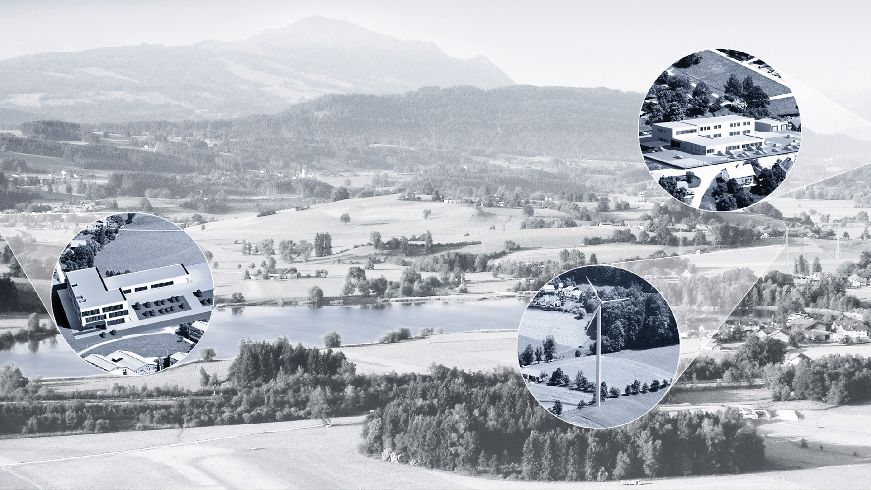
The CLIQ® Solution
Support workflows of employees and vendors across multiple sites
Access control assigned to specific areas, for specific people, at specific times

Slide 10
The CLIQ® Solution
Programmable keys with flexible access rights
High electronic and mechanical security
Robust and reliable locking system
Easy installation: no wiring or cables

Slide 11
Energy companies around the world trust CLIQ® to secure their critical infrastructure

Slide 12
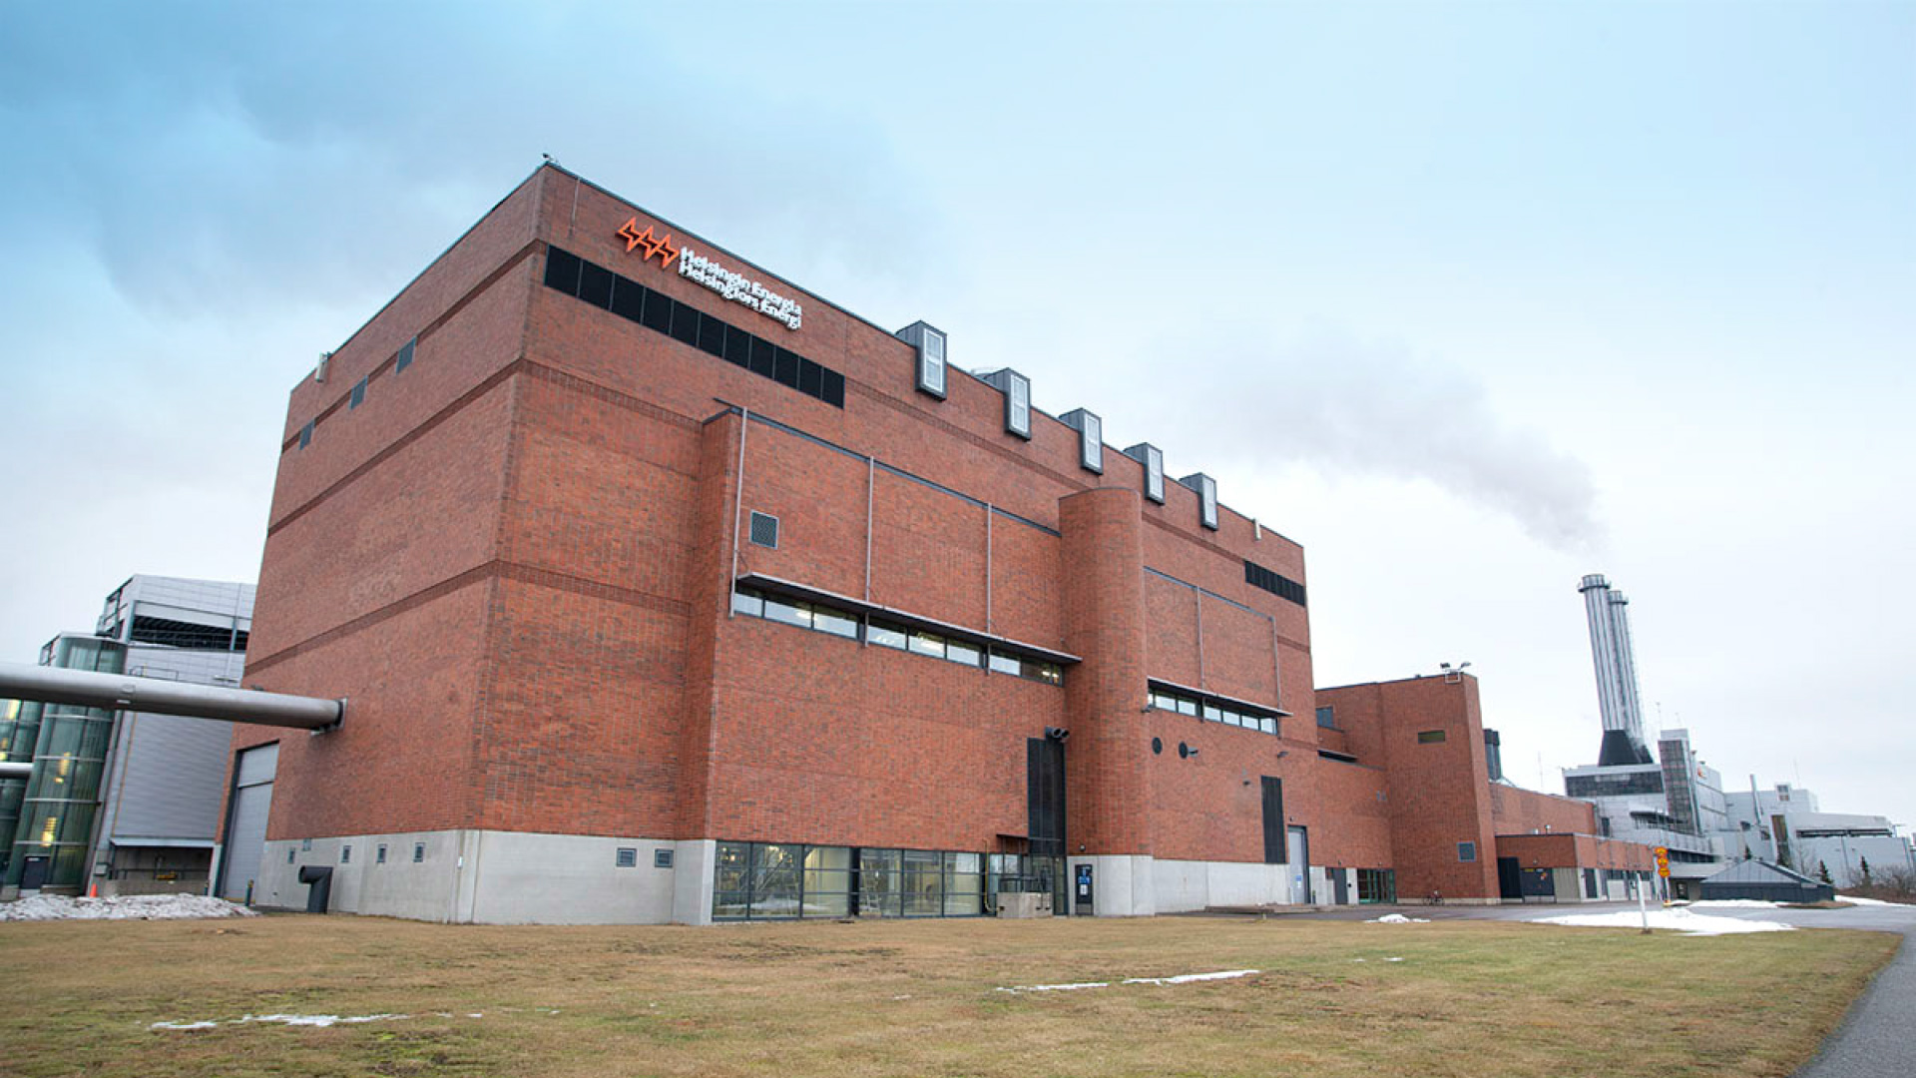
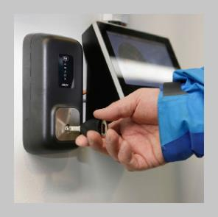
Helsingen Energie, Finland
Supplies electricity to 400,000 homes
3,500 door openings secured with CLIQ®

Slide 13
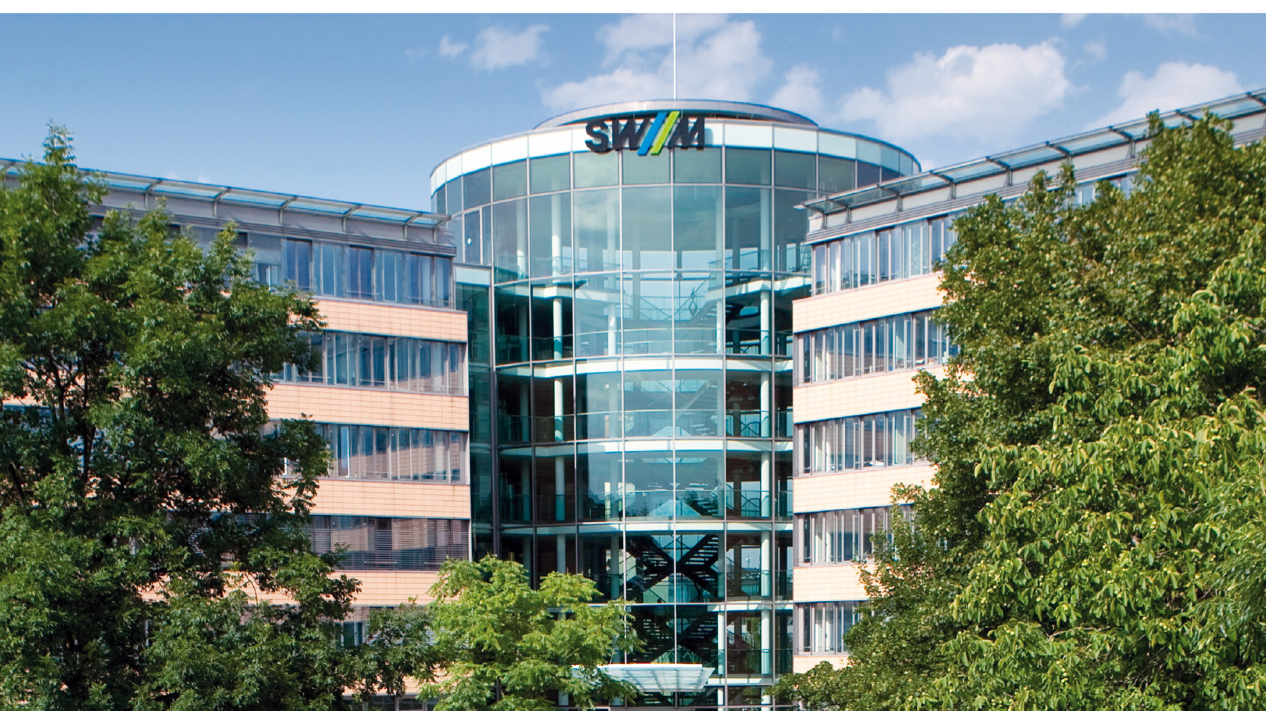
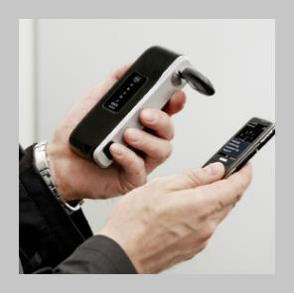
Stadtwerke München, Germany
Largest regional utility company in Germany
11,000 CLIQ® cylinders installed

Slide 14
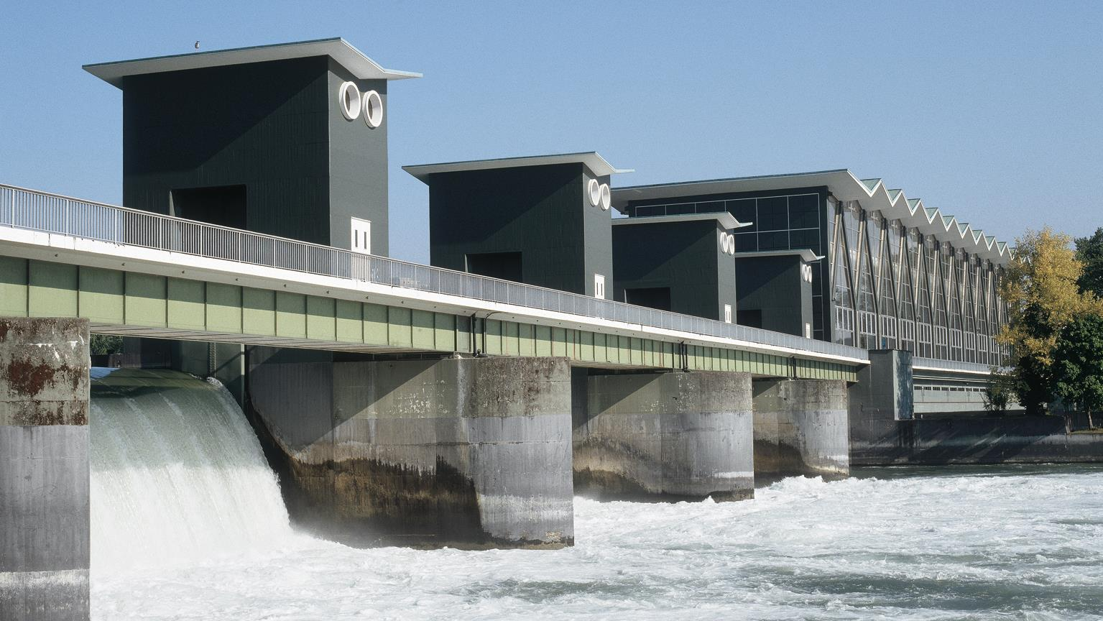
Stadtwerke Basel, Switzerland
Supplies around 190,000 customers in Basel and north-western Switzerland with electricity, district heating, biogas and natural gas, energy services, telecommunications and safe drinking water

Slide 15
Contact us to find out more

